Slide 1


Pittsburgh Pennsylvania 311 Data analysis
Alan Dalton, Firouz (Phil) Karimov, Jacqueline Williams

Slide 2
Motivation and summary
“Why 311 data?” – 911 data would have been too large…
Some of the questions we had
What is the top call in issue
Is there a particular neighborhood with a higher call-in rate
Are there any economical correlations(more calls for lower or vise versa)
Do certain neighborhoods have more repair requests
Do certain times of year have higher request
How weather events affect number of request
With our questions, we were off with our exploration.

Slide 3
Data Cleanup and exploration
Using the Data.Gov site, we located a file representing 311 Data for Pittsburgh, PA(325K data set). We will be collecting census data via an API to determine social economic status based on zip code obtained from Google places API.
Merging social economic data(Columns TBD) and zip code
We will be cleaning data(NaN), and Nulls
Pulling out the top 5 Neighborhoods and Call Type

Slide 4
Technology used
Data.gov CSV file of 311 data
Census API
Google Places API
Pandas to create DataFrame
Matplolib to create charts
And any other Python Libraries in necessary

Slide 5
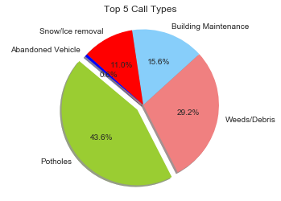
Top 5 call types
Immediately noticed Potholes and Weeds/Debris as being the largest of the top 5
request_top = df['REQUEST_TYPE'].value_counts()[:5]
plt.title("Top 5 Call Types", y=1.02);
colors = ['yellowgreen', 'lightcoral', 'lightskyblue', 'red', 'blue']
explode = (0.1, 0, 0, 0, 0)
plt.pie(request_top, explode=explode,
labels=request_top.index,
colors=colors,
autopct='%1.1f%%', shadow=True, startangle=140)
plt.axis('equal')
plt.show();

Slide 6
Call count by Month/year
We can see by date on Jan 2018 a large spike for Snow/Ice removal followed by Potholes and another Pothole spike in April of 2018 as winter ends.
df['CREATE_DATE'].value_counts().plot
(kind='bar', figsize=(20, 18))
plt.xlabel("MONTH/YEAR", labelpad=18)
plt.ylabel("Count", labelpad=18)
plt.title("Month/Year");

Slide 7
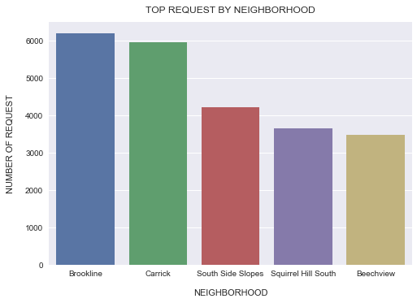

Top 5 Neighborhood's
For the top 5 calls, we have Brookline and Carrick as placing the majority of the calls
neighbor_top = df['NEIGHBORHOOD'].value_counts()[:5]
neighbor_top_df = pd.DataFrame({"neighborhood":neighbor_top.index,"request":neighbor_top})
sns.barplot(x="neighborhood", y="request", data=neighbor_top_df)
plt.xlabel("NEIGHBORHOOD", labelpad=14)
plt.ylabel("NUMBER OF REQUEST", labelpad=14)
plt.title("TOP REQUEST BY NEIGHBORHOOD", y=1.02)

Slide 8
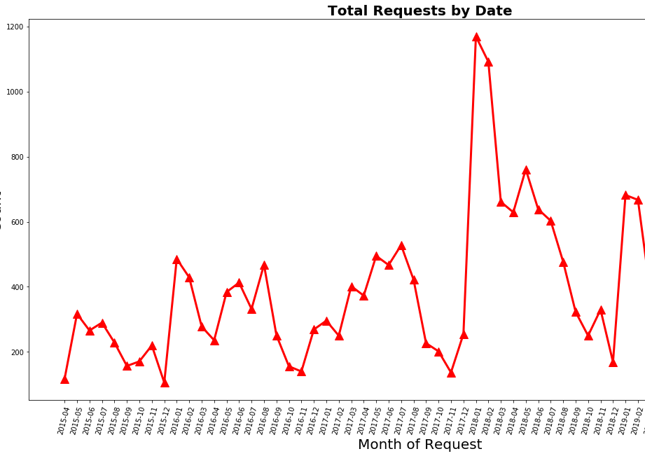
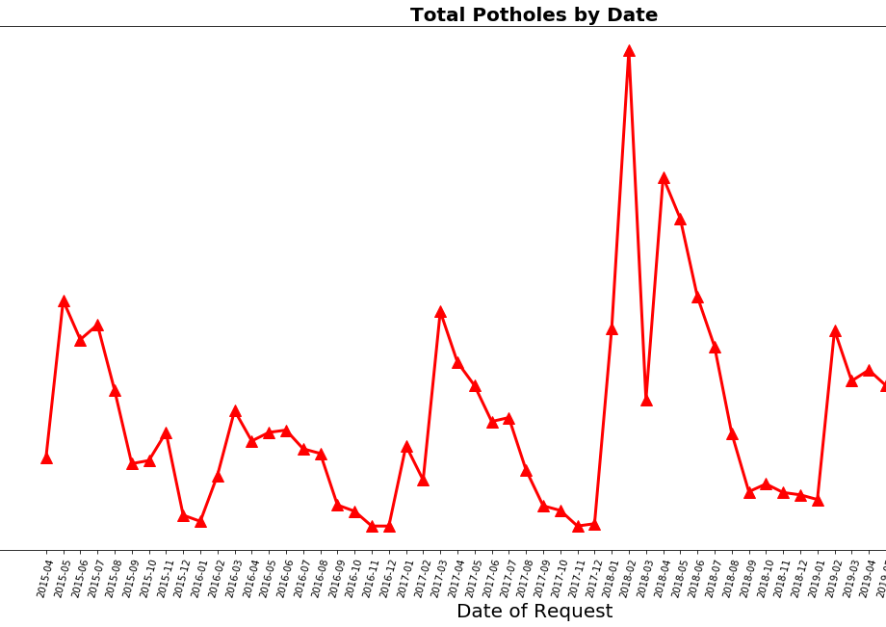
Call count by Month/year

Slide 9
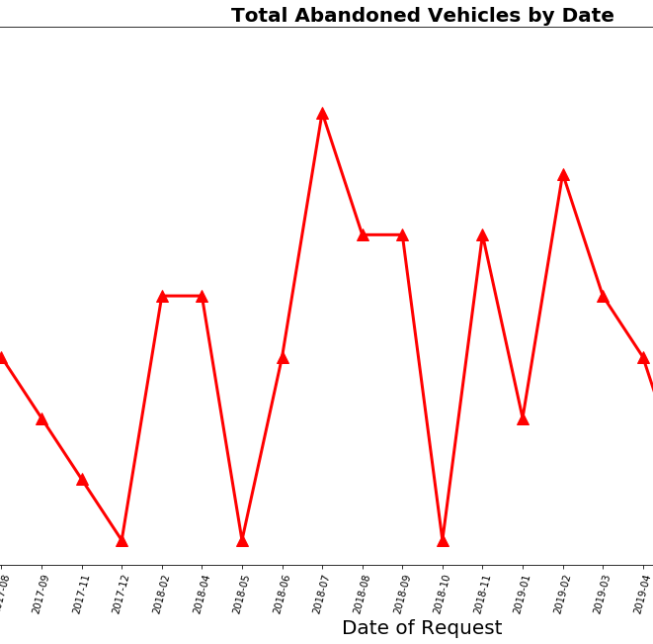
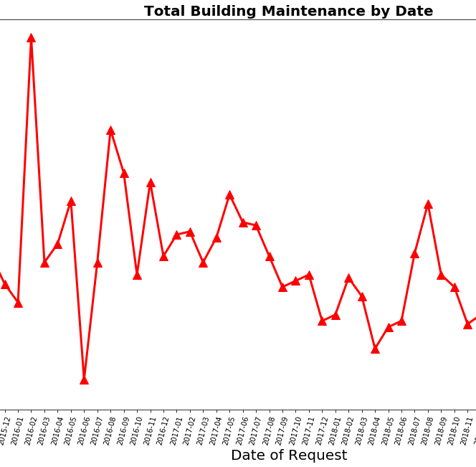
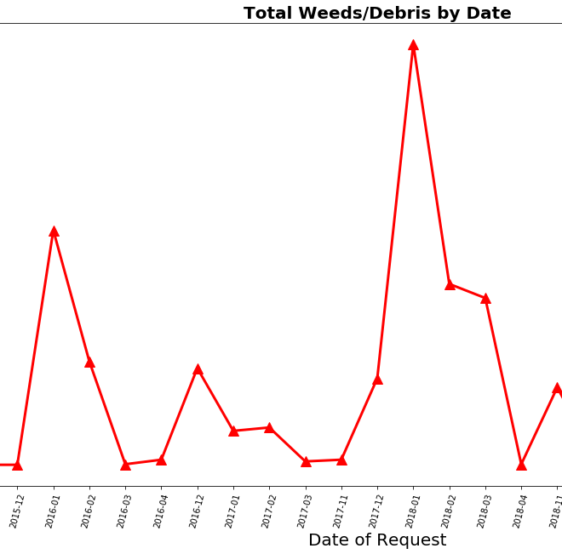
Call count by Month/year

Slide 10
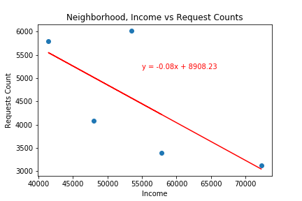
Neighborhood income vs call
Although very few data points, we can see the lower income have higher call in request

Slide 11
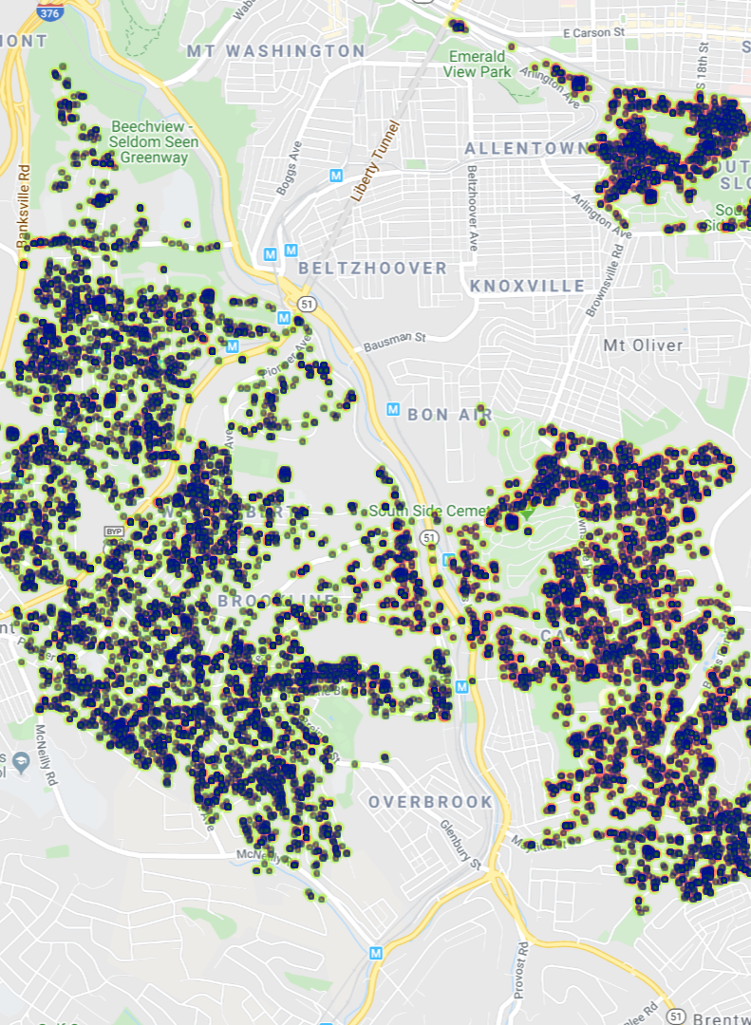
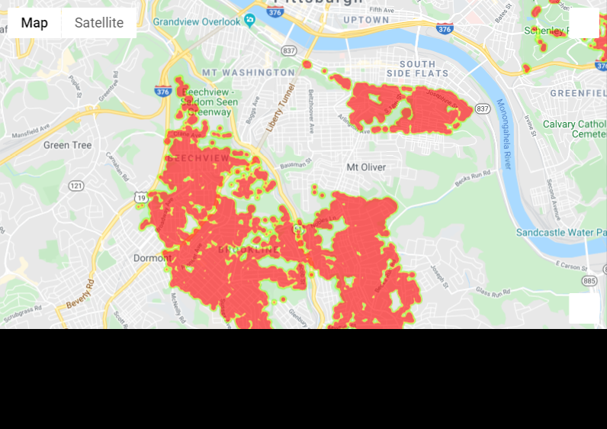
Economical correlations
South Side Slopes
South Side Slopes
Brookline
Carrick
Carrick
Brookline
Area’s of Poverty
Originating Call Request
Steps/data analysis then chart?

Slide 12
Discussion
Did we find what we expected? Anything unexpected?
The original file was labeled as Philadelphia but when we were cleaning data and pulling zip codes, we realized it all was really for Pittsburgh.
Original file was 400K and API calls to google were taking (multiple hours).
Any conclusions we can pull from analysis
In January 2018 there was an obvious spike in Snow/Ice removal followed by an increase of Pothole calls in Feb and April of 2018 proving snow and ice do cause potholes….
Lower income neighborhoods are more apt to call in with issues(do they receive the same amount of service as the richer neighborhoods?)
With more time, past snow accumulations could be pulled in as well.

Slide 13

questions
?

